Slide 1
Mathematical Foundations for ML (10-606):
Probability
Bryan Wilder
* Slides borrowed from prior offerings by Professors M. Gormley, P. Virtue, & G. Gordon, & H. Heidari.

Slide 2
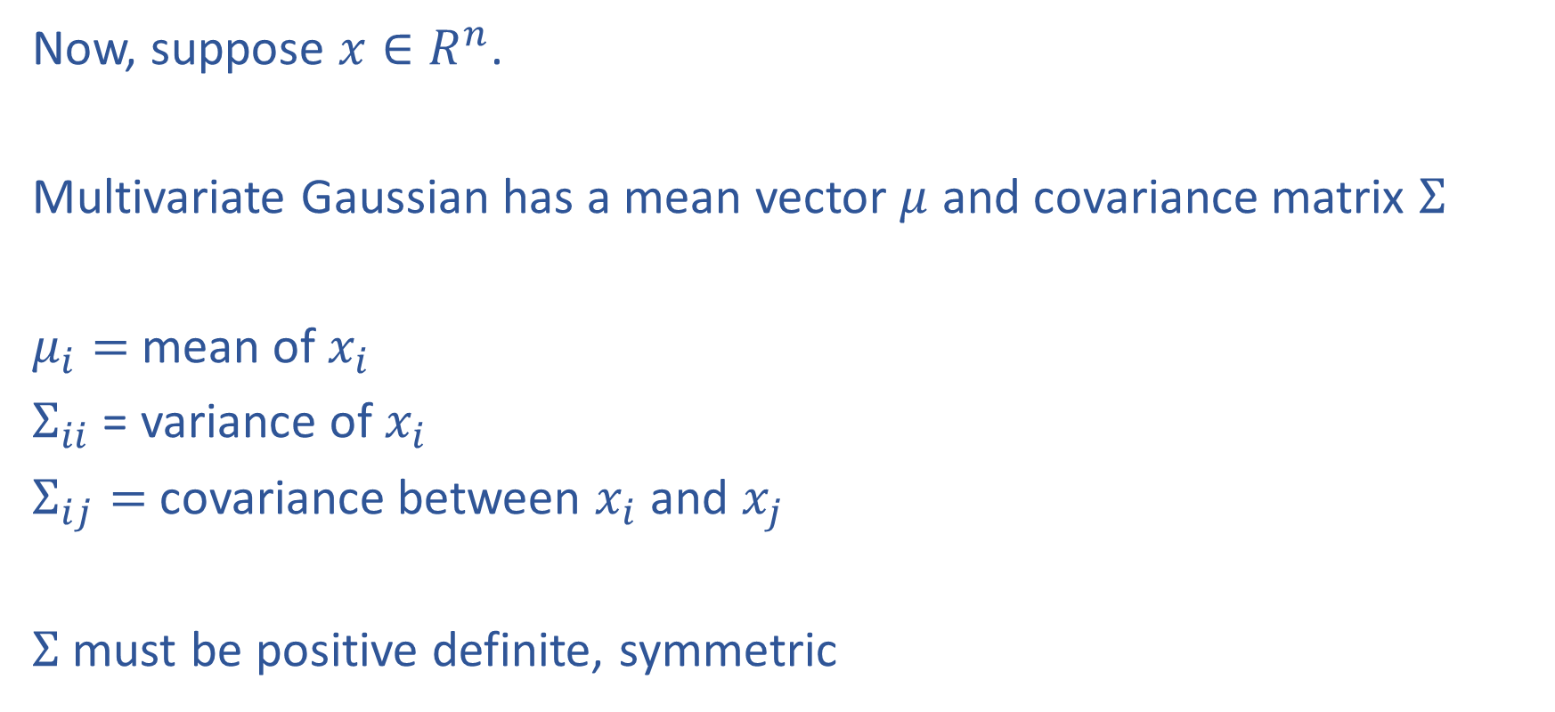
Multivariate Gaussian
Now, suppose $x∈R^{n}$.
Multivariate Gaussian has a mean vector $μ$ and covariance matrix $Σ$
$μ_{i}=$mean of $x_{i}$
$Σ_{ii}$ = variance of $x_{i}$
$Σ_{ij}=$covariance between $x_{i}$ and $x_{j}$
$Σ$ must be positive definite, symmetric

Slide 3
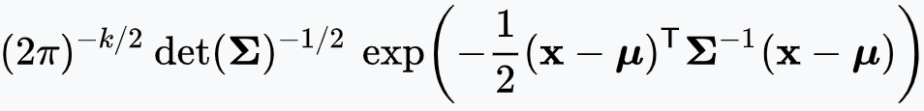
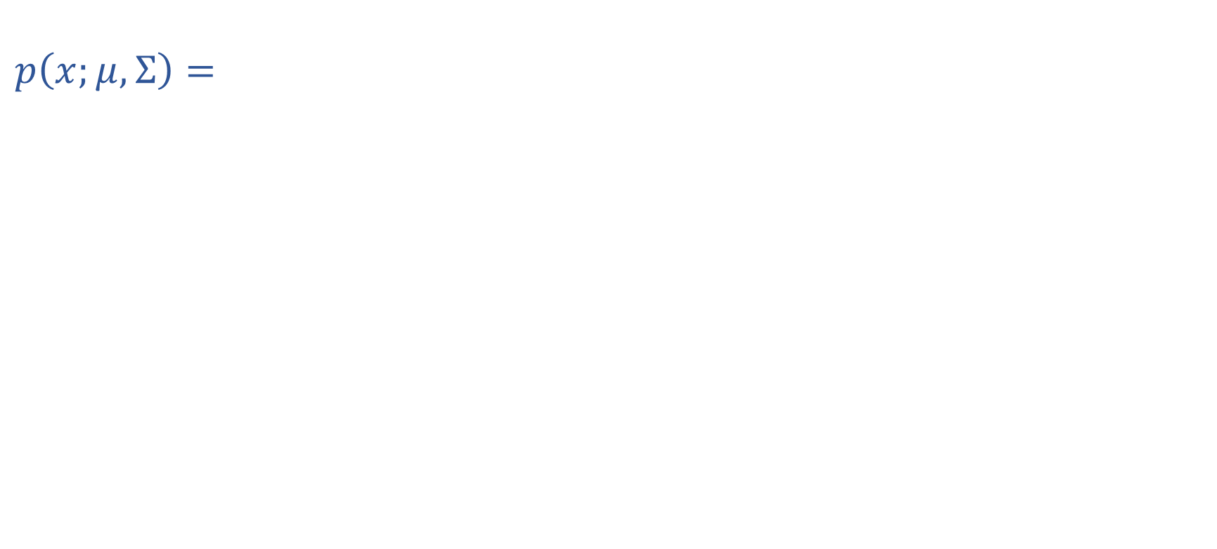
Multivariate Gaussian
$$p\left(x;μ, Σ\right)=$$
Distance from $x$ to $μ$ under norm induced by $Σ^{−1}$

Slide 4
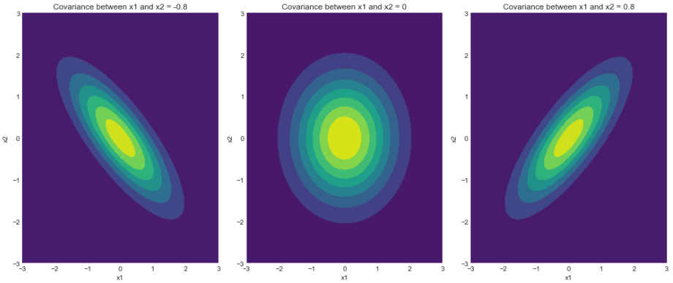
Multivariate Gaussian
https://www.geeksforgeeks.org/visualizing-the-bivariate-gaussian-distribution-in-python/

Slide 5
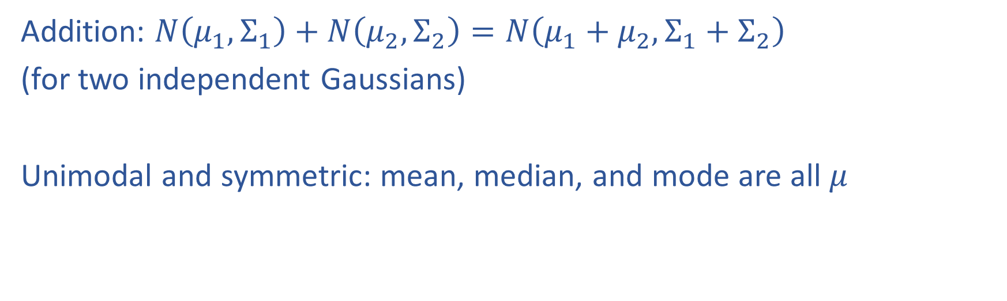
Properties of Gaussians
Addition: $N\left(μ_{1}, Σ_{1}\right)+N\left(μ_{2}, Σ_{2}\right)=N\left(μ_{1}+μ_{2}, Σ_{1}+Σ_{2}\right)$
(for two independent Gaussians)
Unimodal and symmetric: mean, median, and mode are all $μ$

Slide 6
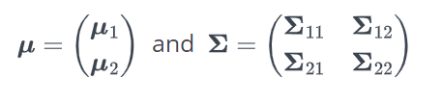
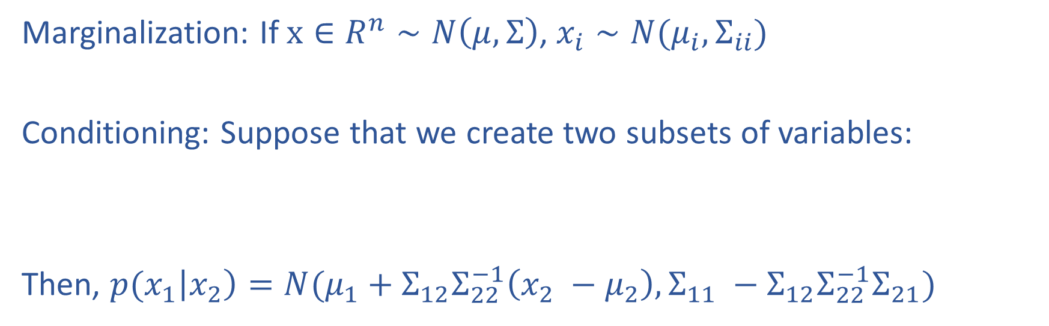
Properties of Gaussians
Marginalization: If $x∈R^{n}∼N\left(μ, Σ\right)$, $x_{i}∼N(μ_{i}, Σ_{ii})$
Conditioning: Suppose that we create two subsets of variables:
Then, ${p(x}_{1}\left|x_{2}\right)=N(μ_{1}+Σ_{12}Σ_{22}^{−1}\left(x_{2} −μ_{2}\right), Σ_{11} −Σ_{12}Σ_{22}^{−1}Σ_{21})$

Slide 7
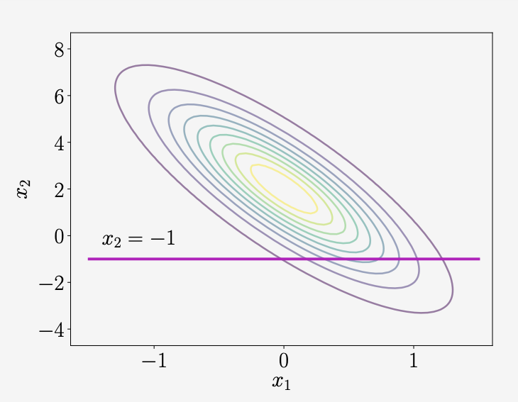
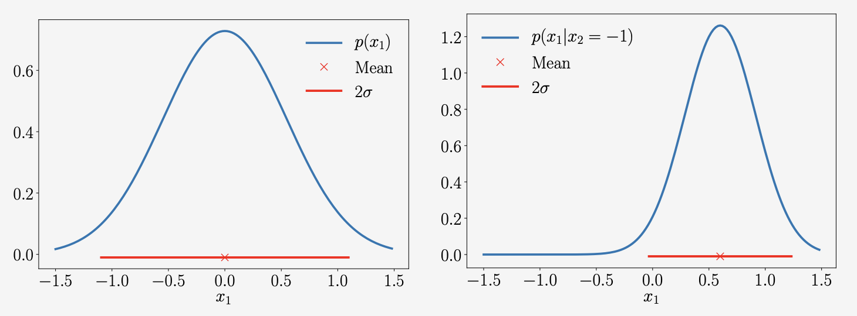
Example
Marginal
Conditional

Slide 8
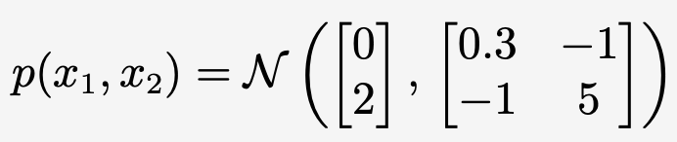
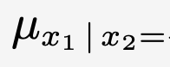
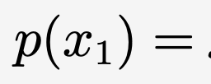
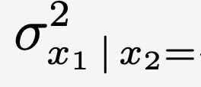
Example
Notes:
$${p(x}_{1}\left|x_{2}\right)=N(μ_{1}+Σ_{12}Σ_{22}^{−1}\left(x_{2} −μ_{2}\right), Σ_{11} −Σ_{12}Σ_{22}^{−1}Σ_{21})$$

Slide 9
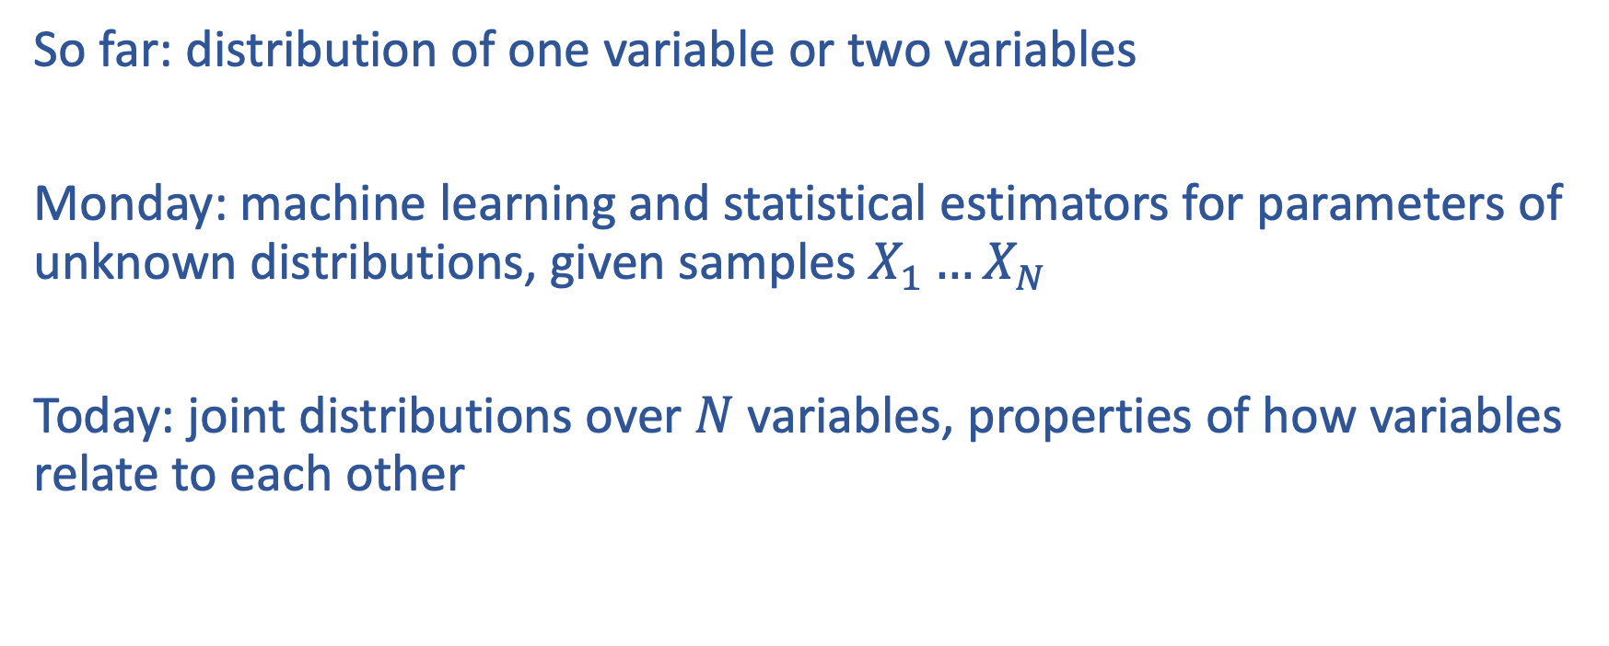
Describing relationships between many random variables
So far: distribution of one variable or two variables
Monday: machine learning and statistical estimators for parameters of unknown distributions, given samples $X_{1}…X_{N}$
Today: joint distributions over $N$ variables, properties of how variables relate to each other

Slide 10
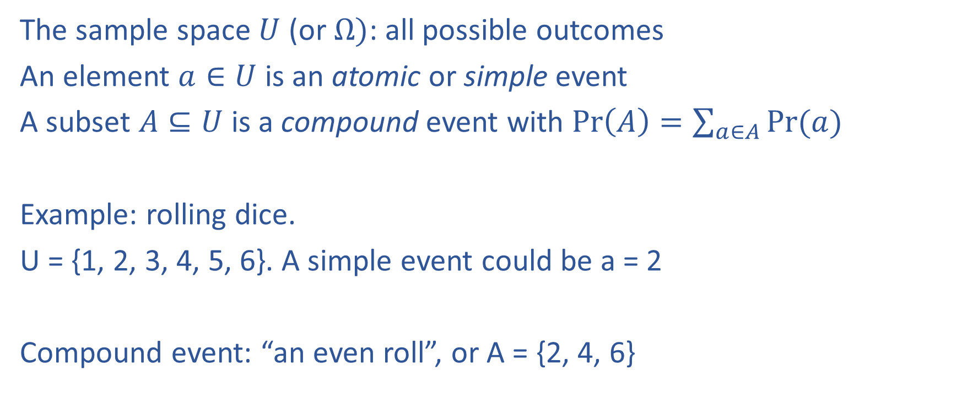
Formalization
The sample space $U$ (or $Ω)$: all possible outcomes
An element $a∈U$ is an atomic or simple event
A subset $A⊆U$ is a compound event with $\operatorname{Pr}\left(A\right)=\sum_{a∈A}{Pr⁡(a)}$
Example: rolling dice.
U = {1, 2, 3, 4, 5, 6}. A simple event could be a = 2
Compound event: “an even roll”, or A = {2, 4, 6}

Slide 11
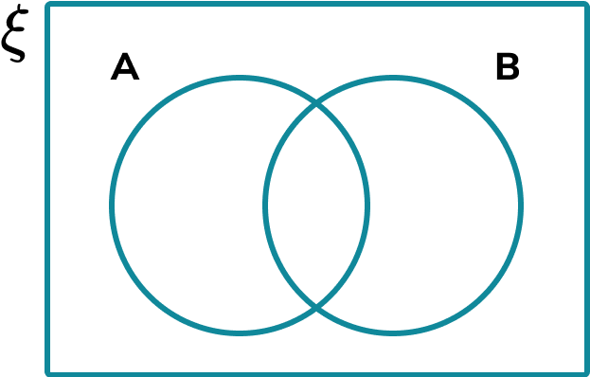
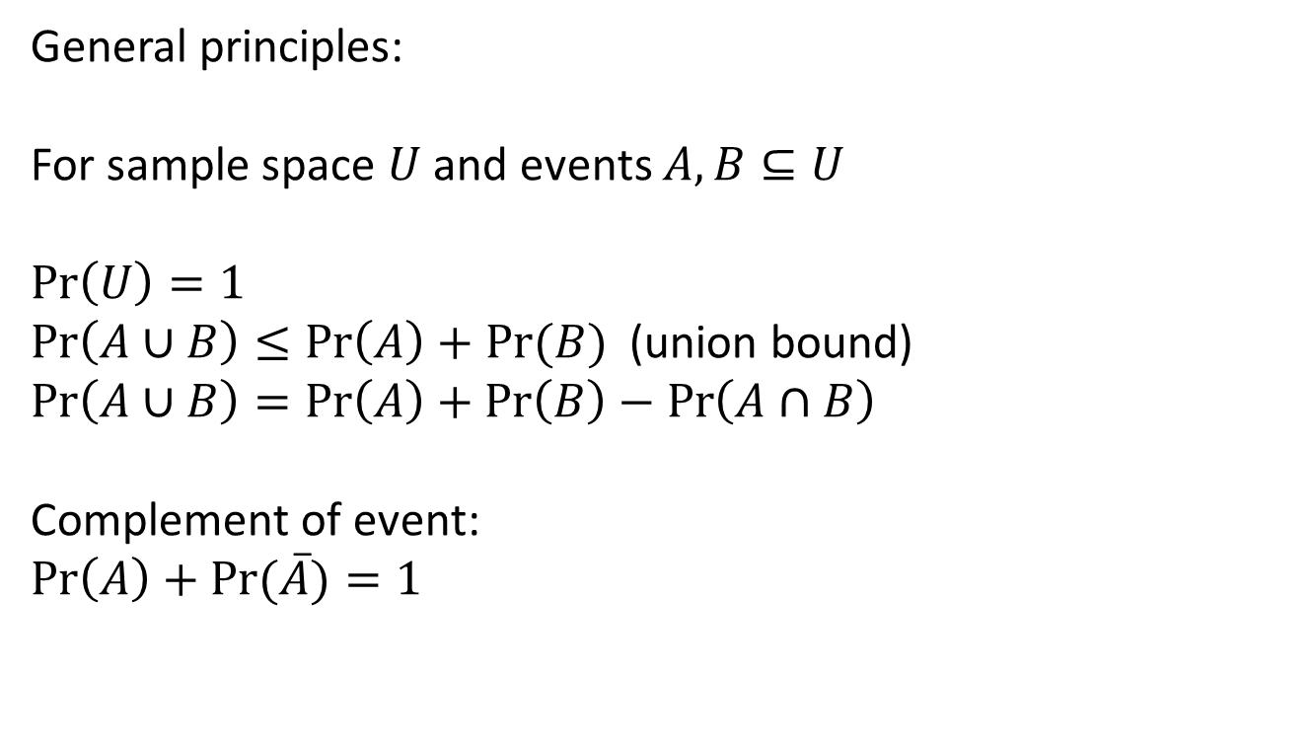
Formalization
General principles:
For sample space $U$ and events $A, B⊆U$
$$\operatorname{Pr}\left(U\right)=1$$
$\operatorname{Pr}\left(A∪B\right)≤\operatorname{Pr}\left(A\right)+Pr⁡(B)$ (union bound)
$$\operatorname{Pr}\left(A∪B\right)=\operatorname{Pr}\left(A\right)+\operatorname{Pr}\left(B\right)−\operatorname{Pr}\left(A∩B\right)$$
Complement of event:
$$\operatorname{Pr}\left(A\right)+\operatorname{Pr}{(\overline{A})}=1$$

Slide 12
Random variables
A random variable is a function of an atomic event:
“I flip a coin. If it comes up heads, I get $5. If tails, I lose $2”
f: {H, T} → R
f(H) = 5; f(T) = -2

Slide 13
Random variables
Can map to any output set
“I generate a random number uniformly in [0,1]. If it’s < 0.5, I output 0 and if >= 0.5, output 1”
f: [0,1] -> {0,1}

Slide 14
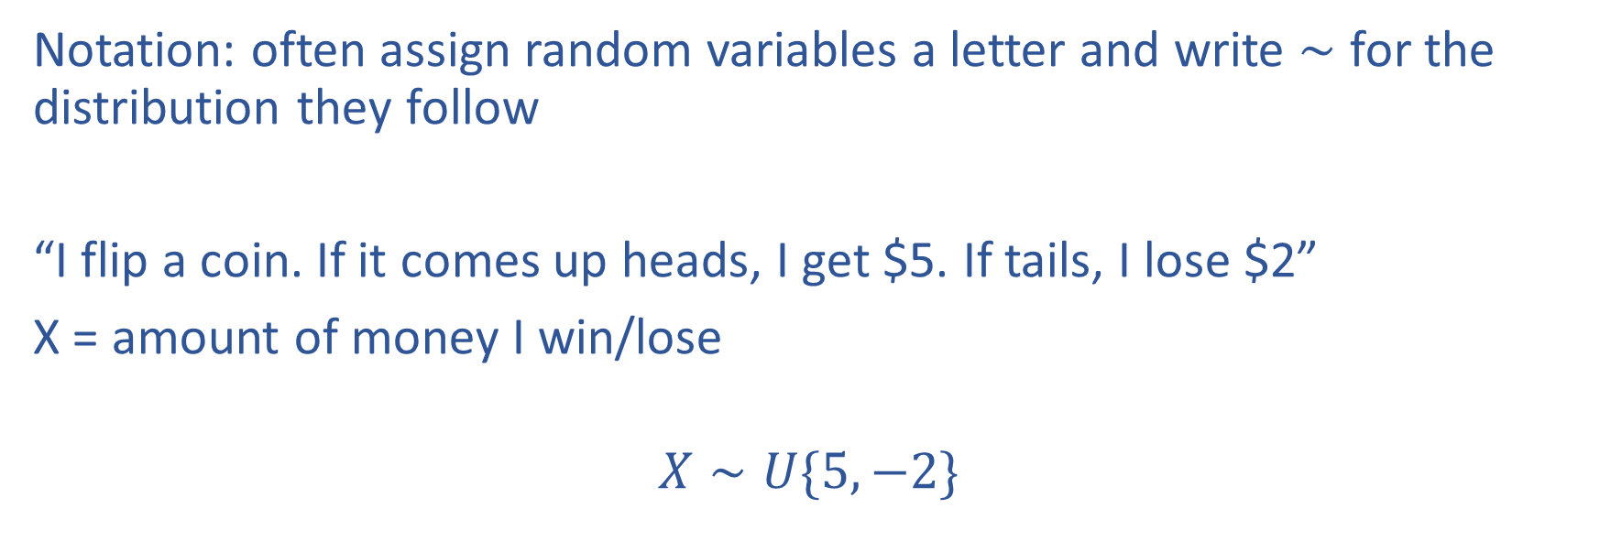
Random variables
Notation: often assign random variables a letter and write $∼$ for the distribution they follow
“I flip a coin. If it comes up heads, I get $5. If tails, I lose $2”
X = amount of money I win/lose
$$X∼U\{5, −2\}$$

Slide 15
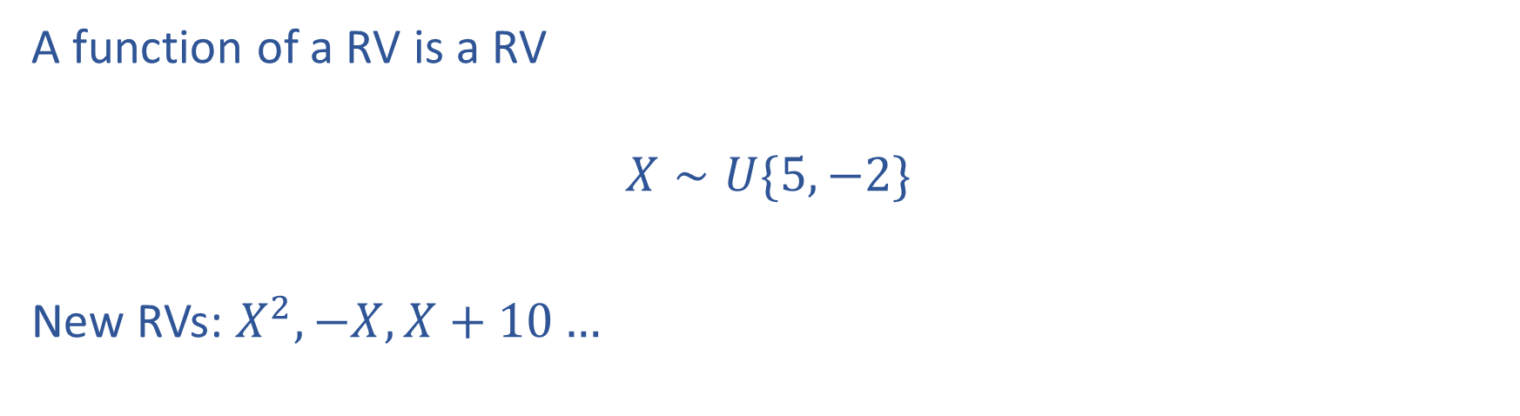
Random variables
A function of a RV is a RV
$$X∼U\{5, −2\}$$
New RVs: $X^{2}, −X, X+10…$

Slide 16
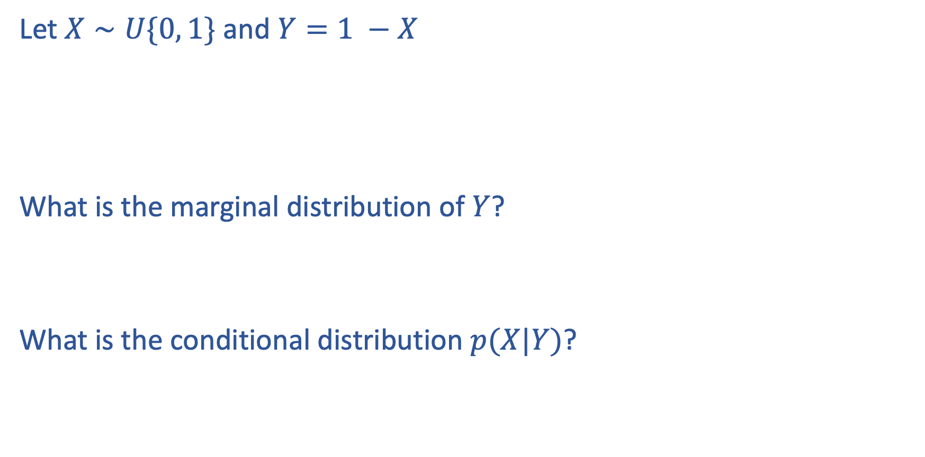
Problem
Let $X∼U\{0, 1\}$ and $Y=1 −X$
What is the marginal distribution of $Y$?
What is the conditional distribution $p(X|Y)$?

Slide 17
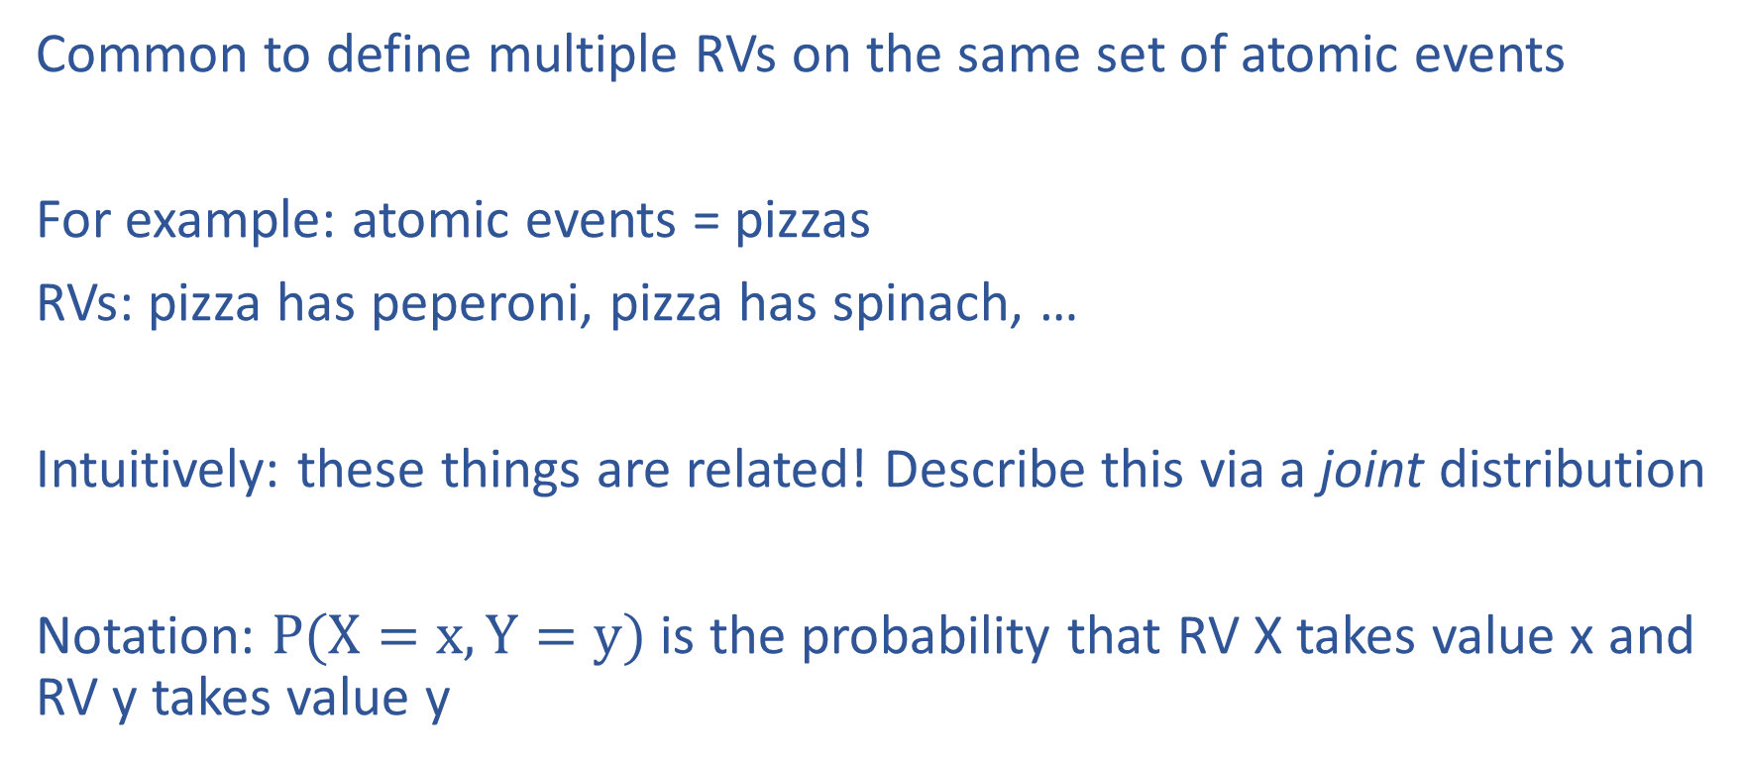
Joint distributions
Common to define multiple RVs on the same set of atomic events
For example: atomic events = pizzas
RVs: pizza has peperoni, pizza has spinach, …
Intuitively: these things are related! Describe this via a joint distribution
Notation: $P(X=x, Y=y)$ is the probability that RV X takes value x and RV y takes value y

Slide 18

Joint probabilities
 | Peperoni = 1 | Peperoni = 0
Spinach = 1 | 1/2 | 1/8
Spinach = 0 | 1/8 | 1/4
Sample space is U = {(0, 0), (0, 1), (1, 0), (1, 1)}
Cells sum to 1: $\operatorname{Pr}\left(a∈U\right)=1$

Slide 19
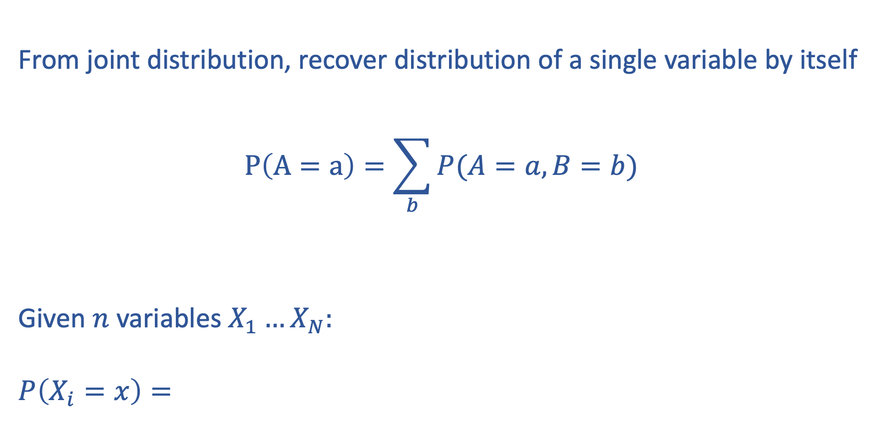
Marginalization over distributions of many variables
From joint distribution, recover distribution of a single variable by itself
$$P\left(A=a\right)=\sum_{b}{P(A=a, B=b)}$$
Given $n$ variables $X_{1}…X_{N}:$
$$P\left(X_{i}=x\right)=$$

Slide 20

Conditional probability
$$p\left(A | B\right)=\frac{p\left(A, B\right)}{p(B)}$$
Interpretation: probability A happens given B happened

Slide 21
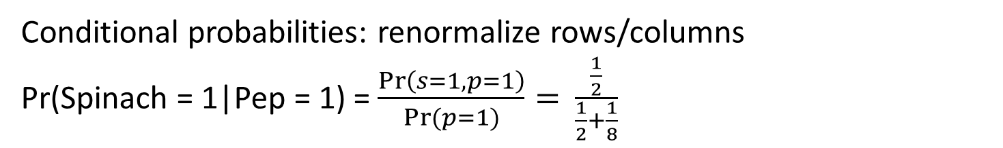
Probability table: joint probabilities
 | Peperoni = 1 | Peperoni = 0
Spinach = 1 | 1/2 | 1/8
Spinach = 0 | 1/8 | 1/4
Conditional probabilities: renormalize rows/columns
Pr(Spinach = 1|Pep = 1) = $\frac{\operatorname{Pr}\left(s=1,p=1\right)}{\operatorname{Pr}{(p=1)}}=$ $\frac{\frac{1}{2}}{\frac{1}{2}+\frac{1}{8}}$

Slide 22
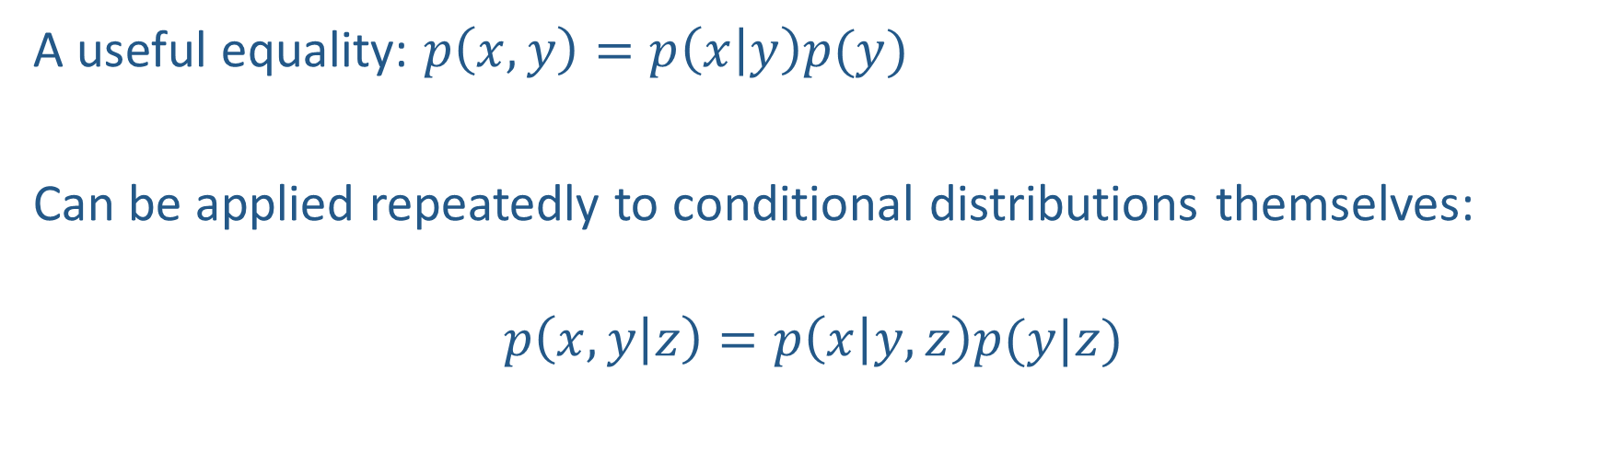
The chain rule
A useful equality: $p\left(x,y\right)=p\left(x | y\right)p(y)$
Can be applied repeatedly to conditional distributions themselves:
$$p\left(x, y | z\right)=p\left(x | y,z\right)p(y|z)$$

Slide 23
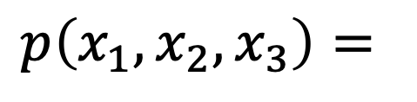
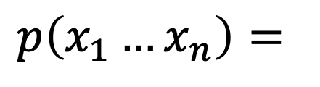
The Chain Rule
More generally, can always write any joint distribution as an incremental product of conditional distributions
$$p\left(x_{1}, x_{2},x_{3}\right)=$$
$$p\left(x_{1}…x_{n}\right)=$$
Notes:
Show multiple different factorizations

Slide 24
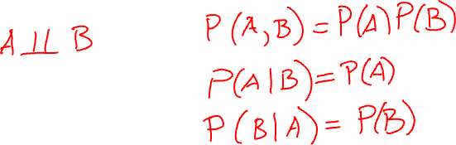
Independence
Variables where knowing one does not reveal any information about the other
Notes:
A \perp B
P(A, B) = P(A, B)
P(A|B) = P(A)
P(B|A) = P(B)

Slide 25
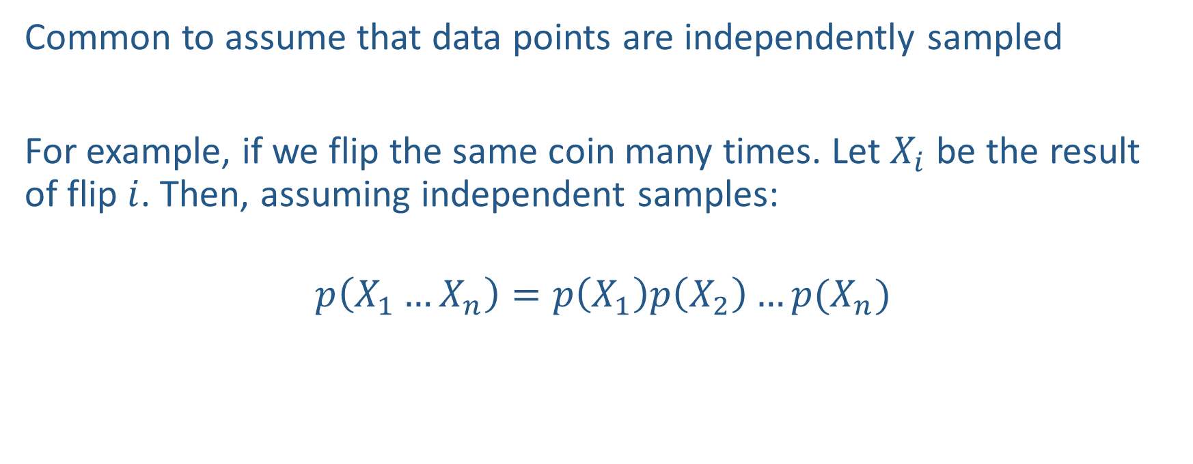
Independent samples
Common to assume that data points are independently sampled
For example, if we flip the same coin many times. Let $X_{i}$ be the result of flip $i$. Then, assuming independent samples:
$$p\left(X_{1}…X_{n}\right)=p\left(X_{1}\right)p\left(X_{2}\right)…p(X_{n})$$

Slide 26
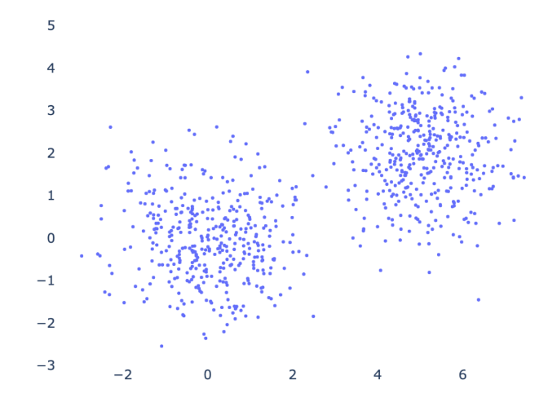
Conditional independence

Slide 27


Conditional Independence

Slide 28
Probabilistic graphical models

Slide 29
You look at pizzas coming out of the oven at your local pizza place. 50% have spinach and 30% have peperoni. 30% have neither spinach or peperoni. What is the probability that a pizza has both?
Notes:
Pr(s = 1) = 0.5
Pr(p = 1) = 0.3
Pr(p = 0, s = 0) = 0.3
Pr(p = 0, s= 1) + Pr(p = 0, s = 0) = Pr(p = 0) = 1 – Pr(p = 1) = 0.7
Pr(p = 0, s= 1) = 0.4
Pr(p = 0, s = 0) + Pr(p = 1, s = 0) = Pr(s = 0) = 1 – Pr(s = 1) = 0.5
Pr(p = 1, s = 0) = 0.2
Pr(p = 1, s = 1) = 1 – (Pr(p = 0, s = 0) + Pr(p = 1, s = 0) + Pr(p = 0, s = 1)) = 0.1

Slide 30
Problems
Suppose that you roll a dice that comes up either 1, 2, 3, or 4. However, the dice is weighted and may not have uniform probabilities. Let:
A be the event that you roll either a 1 or a 3
B be the event that you roll a 2, 3, or 4
C be the event that you roll a 1
D be the event that you roll a 2 or a 4
Suppose that P(A) = 0.4, P(B) = 0.7, and P(C) = 0.1. What is P(D)?

Slide 31
Problems
Suppose that you roll a dice that comes up either 1, 2, 3, or 4. However, the dice is weighted and may not have uniform probabilities. Let:
A be the event that you roll either a 1 or a 3
B be the event that you roll a 2, 3, or 4
C be the event that you roll a 1
D be the event that you roll a 2 or a 4
Suppose that P(A) = 0.4, P(B) = 0.7, and P(C) = 0.1. What is P(D)?
P({3}) = P(A) – P(C) = 0.3
P(D) = P({2, 4}) = P(B) – P({3}) = 0.4

Slide 32
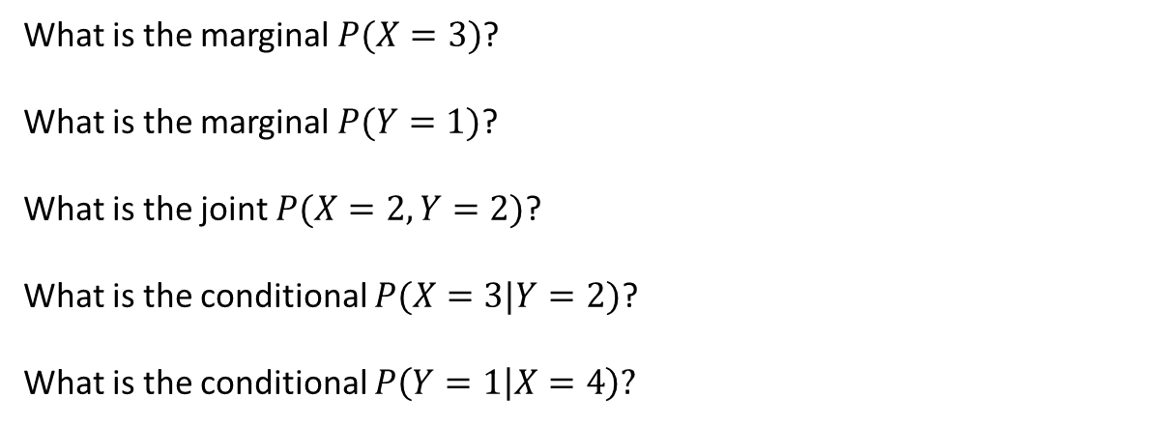
Probability table
X/Y | 1 | 2
0 | 0.1 | 0.1
1 | 0.2 | 0
2 | 0.05 | 0.1
3 | 0.15 | 0.1
4 | 0.05 | 0.15
What is the marginal $P(X=3)$?
What is the marginal $P(Y=1)$?
What is the joint $P(X=2, Y=2)$?
What is the conditional $P(X=3|Y=2)$?
What is the conditional $P\left(Y=1 | X=4\right)?$

Slide 33
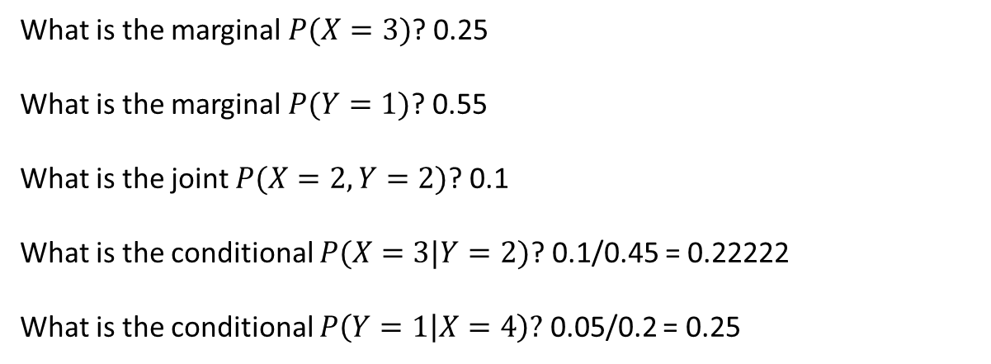
Probability table
X/Y | 1 | 2
0 | 0.1 | 0.1
1 | 0.2 | 0
2 | 0.05 | 0.1
3 | 0.15 | 0.1
4 | 0.05 | 0.15
What is the marginal $P(X=3)$? 0.25
What is the marginal $P(Y=1)$? 0.55
What is the joint $P(X=2, Y=2)$? 0.1
What is the conditional $P(X=3|Y=2)$? 0.1/0.45 = 0.22222
What is the conditional $P\left(Y=1 | X=4\right)?$ 0.05/0.2 = 0.25

Slide 34
You look at pizzas coming out of the oven at your local pizza place. 50% have spinach and 30% have peperoni. 30% have neither spinach or peperoni. What is the probability that a pizza has both?
Pr(s = 1) = 0.5
Pr(p = 1) = 0.3
Pr(p = 0, s = 0) = 0.3

Slide 35
You look at pizzas coming out of the oven at your local pizza place. 50% have spinach and 30% have peperoni. 30% have neither spinach or peperoni. What is the probability that a pizza has both?
Pr(s = 1) = 0.5
Pr(p = 1) = 0.3
Pr(p = 0, s = 0) = 0.3
Pr(p = 0, s= 1) + Pr(p = 0, s = 0) = Pr(p = 0) = 1 – Pr(p = 1) = 0.7
Pr(p = 0, s= 1) = 0.4

Slide 36
You look at pizzas coming out of the oven at your local pizza place. 50% have spinach and 30% have peperoni. 30% have neither spinach or peperoni. What is the probability that a pizza has both?
Pr(s = 1) = 0.5
Pr(p = 1) = 0.3
Pr(p = 0, s = 0) = 0.3
Pr(p = 0, s= 1) + Pr(p = 0, s = 0) = Pr(p = 0) = 1 – Pr(p = 1) = 0.7
Pr(p = 0, s= 1) = 0.4
Pr(p = 0, s = 0) + Pr(p = 1, s = 0) = Pr(s = 0) = 1 – Pr(s = 1) = 0.5
Pr(p = 1, s = 0) = 0.2

Slide 37
You look at pizzas coming out of the oven at your local pizza place. 50% have spinach and 30% have peperoni. 30% have neither spinach or peperoni. What is the probability that a pizza has both?
Pr(s = 1) = 0.5
Pr(p = 1) = 0.3
Pr(p = 0, s = 0) = 0.3
Pr(p = 0, s= 1) + Pr(p = 0, s = 0) = Pr(p = 0) = 1 – Pr(p = 1) = 0.7
Pr(p = 0, s= 1) = 0.4
Pr(p = 0, s = 0) + Pr(p = 1, s = 0) = Pr(s = 0) = 1 – Pr(s = 1) = 0.5
Pr(p = 1, s = 0) = 0.2
Pr(p = 1, s = 1) = 1 – (Pr(p = 0, s = 0) + Pr(p = 1, s = 0) + Pr(p = 0, s = 1)) = 0.1

